Slide 1
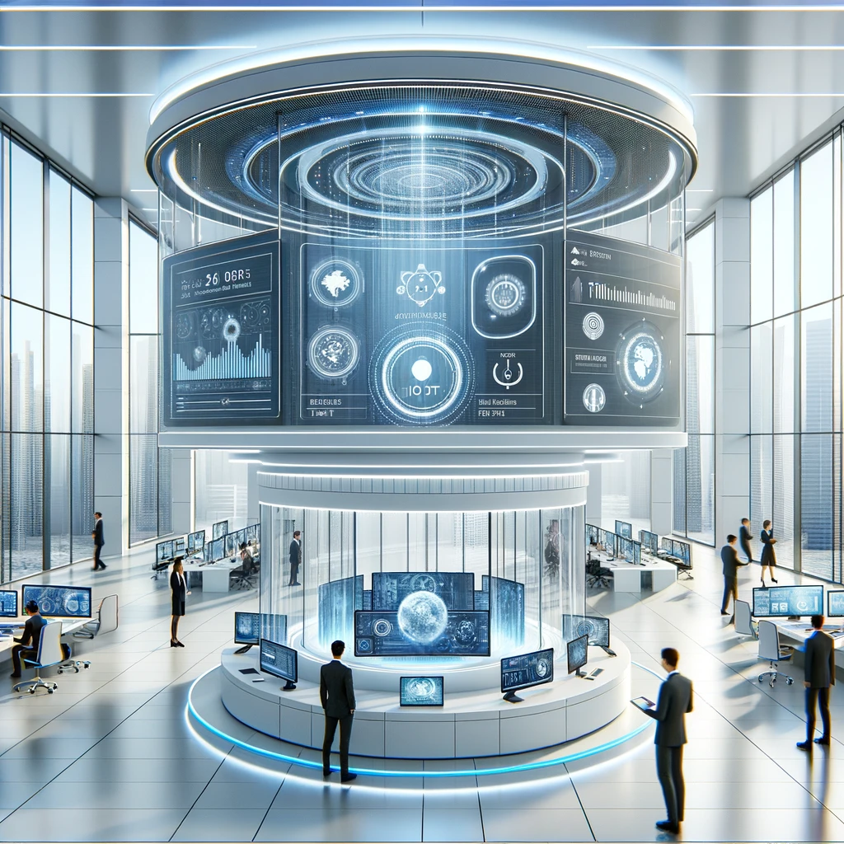
Enhancing Workplace Efficiency and Security with IoT
By Oren Schor & Tal Shvartzberg

Slide 2
Enhancing Workplace Efficiency and Security with IoT
Goal: Utilize IoT to improve productivity, security, and satisfaction in modern workplaces.
Features:
Security - Employee and visitor management – smart access control
Energy management - smart lightning, personalized climate control
Health and safety monitoring – air quality sensors, workers posture *
Integration: Cloud connectivity for real-time data analysis and decision-making.
* La Mura, M., De Gregorio, M., Lamberti, P., & Tucci, V. (2023). IoT System for Real-Time Posture Asymmetry Detection. Sensors (Basel, Switzerland), 23(10), 4830-. https://doi.org/10.3390/s23104830

Slide 3
Why IoT?
IoT has vast potential to revolutionize how workplaces operate, ensuring both employee satisfaction and operational excellence.
IoT's adaptability to rapid changes underscores its potential for quick and innovative responses to global challenges (as during covid for example *).
IoT solutions offer a cost-effective way to enhance operational efficiency and gather real-time insights.
* Tamilselvan, S., Ramesh, R., Niveda, R., Poonguzhali, P., & Dharani, S. (2021). IoT based Touch-free Attendance System (ITAS). Journal of Physics: Conference Series, 1917(1), 12012-. https://doi.org/10.1088/1742-6596/1917/1/012012

Slide 4
Smart Access Control: Facial Recognition and RFID
While the broader vision of our project is the creation of a smart office environment complete with various advanced features, we chose to focus specifically on implementing the smart authentication access component.
Technologies: Facial recognition with RFID backup.
Benefits:
Fast Entry: Immediate facial recognition for employee access.
Secure Records: Image logging on Google Drive; attendance tracked in a local CSV, InfluxDB, and visualized with Grafana.
Reliability: RFID ensures access if facial recognition fails.
Project Repository: link Live Example: link

Slide 5




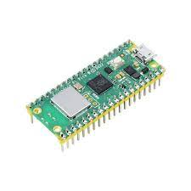
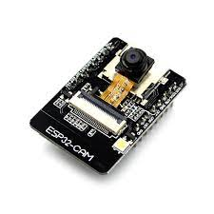


Smart Access Control: Block Diagram
http
https
http
mqtt
http
mqtt
SPI
Gpio (PWM)

Slide 6
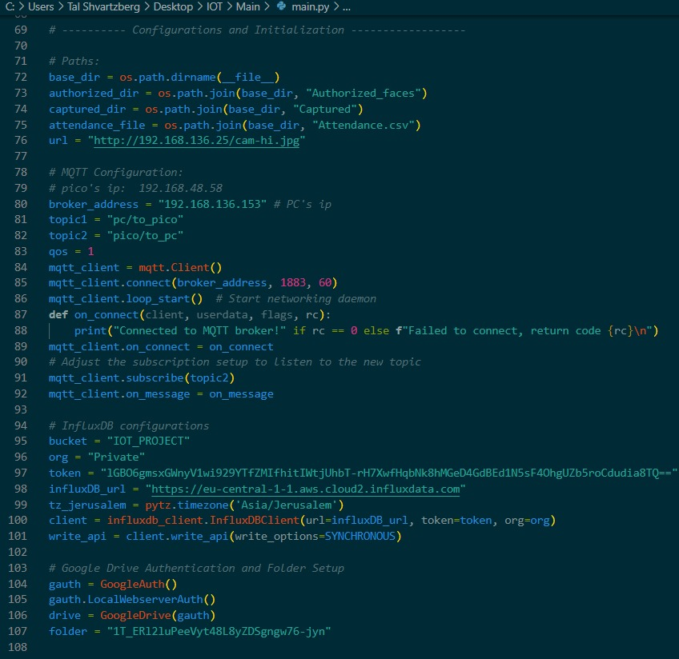
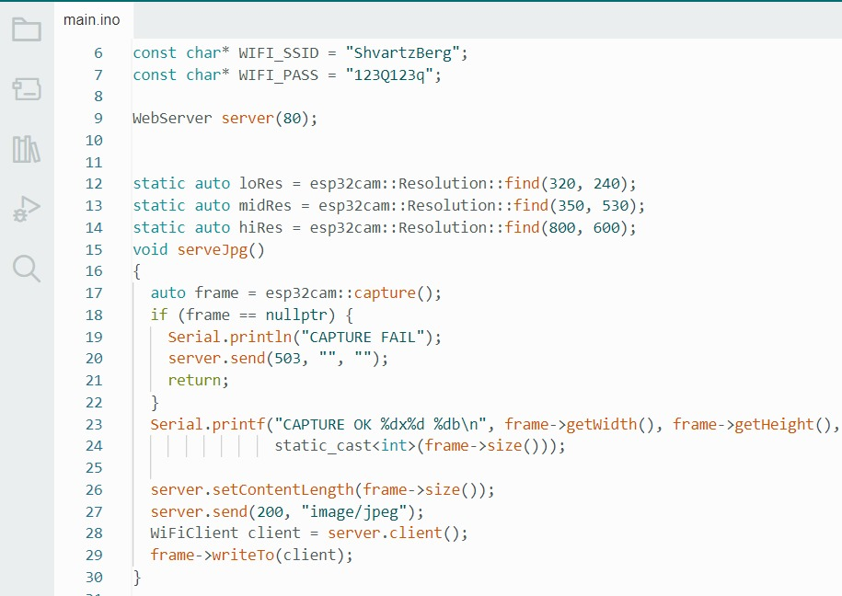
Smart Access Control: Code Parts
Main Server Configurations
ESP32-CAM Configurations
MQTT SETUP
InfluxDB
Google Drive

Slide 7
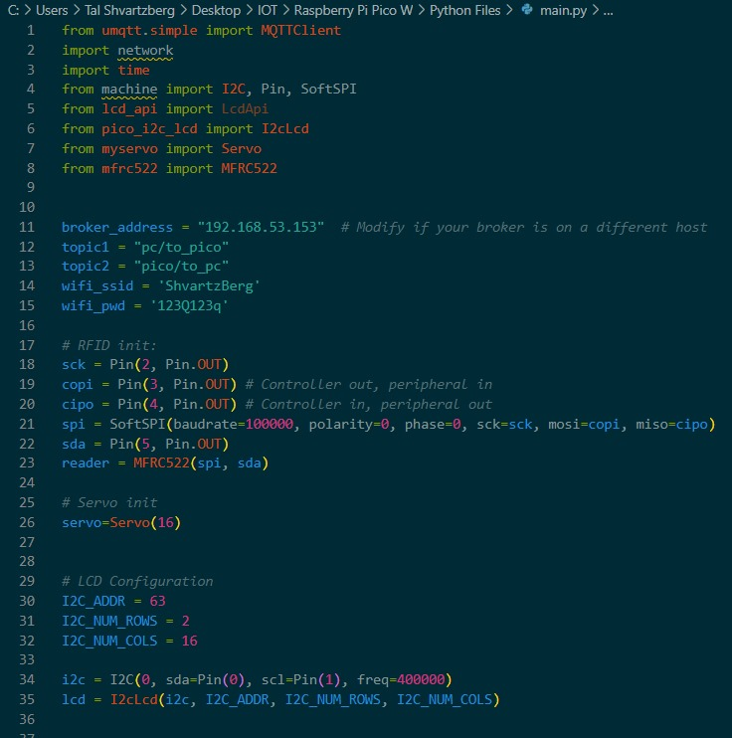
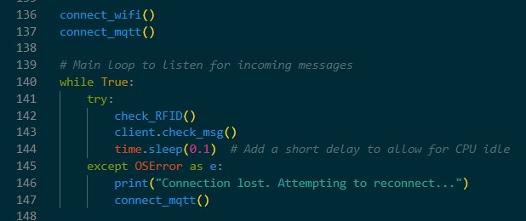
Smart Access Control: Code Parts
Pico Initialization
Pico Loop
Wifi and MQTT
RFID
Servo
LCD

Slide 8
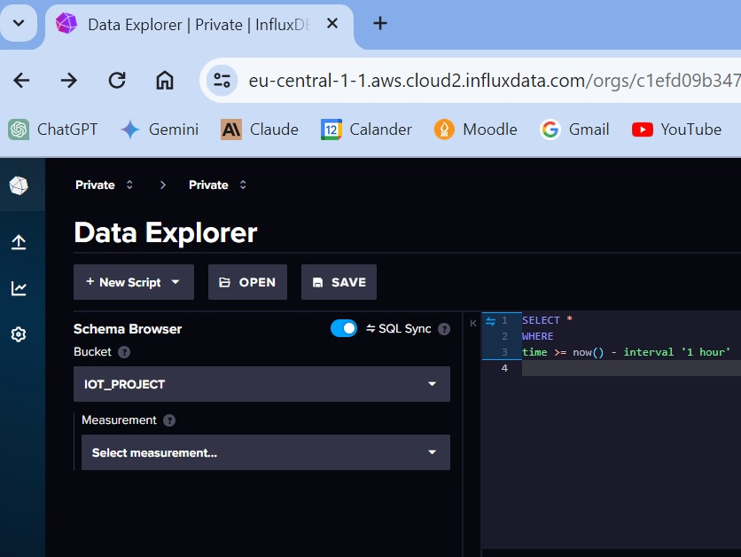
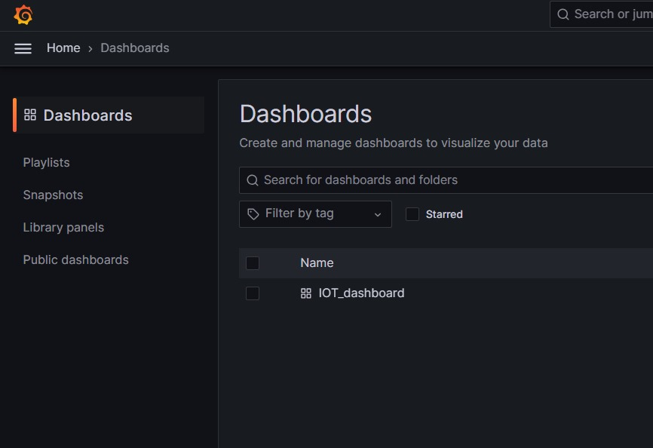

Smart Access Control: InfluxDB and Grafana Integration
InfluxDB Bucket
Grafana Dashboards
Grafana Query

Slide 9
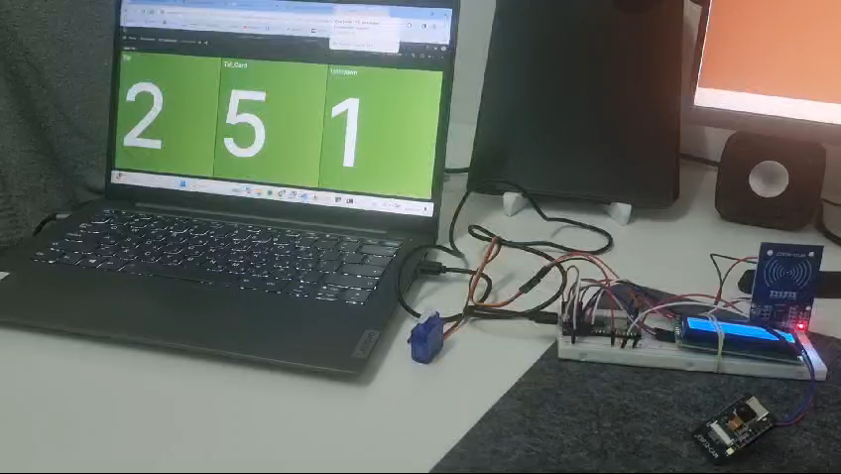
Smart Access Control: InfluxDB and Grafana Integration
Live Example

Slide 10
Intelligent Climate Management for Enhanced Comfort
Another example for the use of IoT in this concept, can be smart climate control.
Objective: Ensure optimal comfort by adjusting to personal preferences, occupancy, and air quality levels. Integrates energy management for sustainability.
Advantages:
Promotes a healthier, more productive work environment through dynamic temperature, humidity, and air quality control.
Improves energy efficiency and reduces costs by optimizing climate settings based on real-time data and occupancy patterns.
Enhances indoor air quality monitoring, ensuring a safe and comfortable environment for all employees.

Slide 11
Empowering Management with IoT Data Insights
Our system can provide managers with actionable insights derived from IoT data:
Access patterns (to workplace and in-workplace facilities)
Environmental preferences
Employee welfare
Energy usage.
These insights support informed decision-making, enabling optimizations that boost efficiency, reduce costs, and improve employee well-being.

Slide 12
Towards a Connected and Efficient Workplace
As we progressed through the project, we imagined an office where IoT technologies make everything work together smoothly.
We really hope to see such improvements in workplaces in the near future.

